Slide 1
AIMS Redesign Subcommittee
November 6th, 2023
Full-Committee Meeting

Slide 2
Agenda
Recap
Evaluation of Existing AIMS Items
Candidates for Addition

Slide 3
Recap
Annual Survey
Existing Variables
Candidates for Addition
October 10th Meeting Recap
Annual Surveys
Release Nov 15th, two months to complete
Will release all materials in summer going forward
Separate Community Ed, make available all year
Existing Variables to Cut
On/Near Reservation
Will use Tribal affiliation as a replacement proxy for community impact
Pre-College Prep (First Time Entering)
HS Type (First Time Entering)
Library Improvements/Acquisitions

Slide 4
Recap
Annual Survey
Existing Variables
Candidates for Addition
AIMS Deadlines/Release
Annual Report
Anticipated Qualtrics Completion: November 15th
Due Date: Jan 19
Part-B already sent out
Pre-Populated Sections
Campus Locations
ISC & FTE Spring numbers
Non-Federal Operational Funding
Academic Buildings
Academic Core Courses
Remedial/Developmental Courses

Slide 5
Recap
Annual Survey
Existing Variables
Candidates for Addition
AIMS Variable Evaluation (Existing)
Selection Process:
Individual review of Annual, Spring, Fall Surveys
Variables not reported out nor requested in the past year
List further refined by Student Success Team
Pre-College Preparation
High School Type
Program Offerings (Annual Survey)
Library Improvements/ Acquisitions
Academic Core Completion
Average Family Income (Replace with EFC)

Slide 6
Recap
Annual Survey
Existing Variables
Candidates for Addition
AIMS Variable Evaluation (Existing)
Considerations:
Relevance – Does the variable provide meaningful insights relevant to the goal of AIMS.
Actionability – Does the variable inform actionable decisions?
How would institutions utilize this information if made available to them annually? Longitudinally or via dashboard?

Slide 7
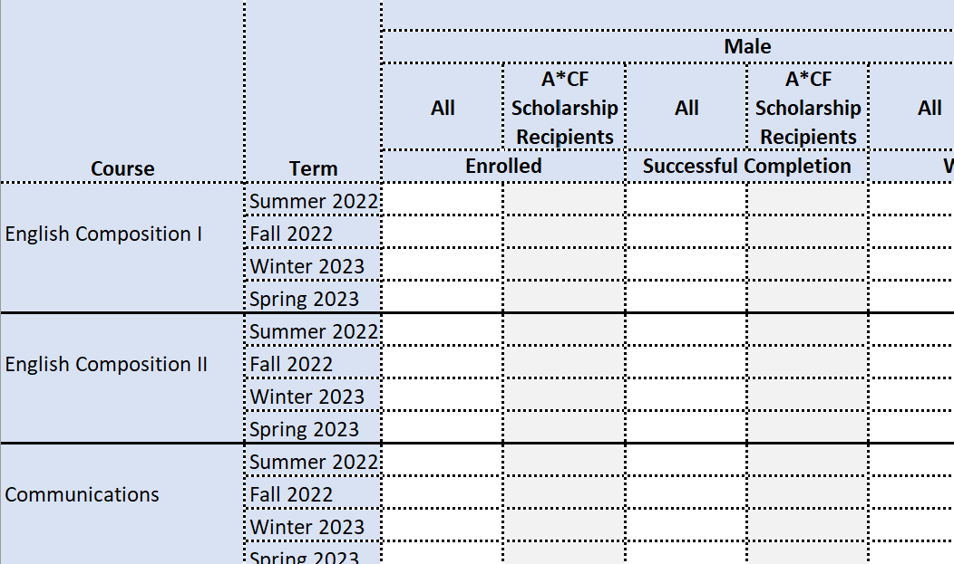
Academic Core Enrollment/Completion
Relevance: Does the variable provide meaningful insights relevant to the goal of AIMS.
Actionable: Does the variable inform actionable decisions?
How would institutions utilize this information if made available to them annually? Longitudinally or via dashboard?
Recap
Annual Survey
Existing Variables
Candidates for Addition

Slide 8
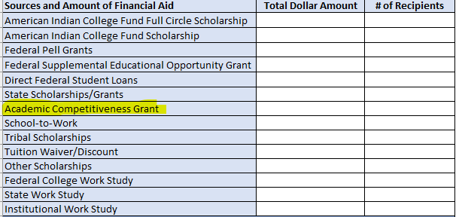
Financial Aid Sources:
Academic Competitiveness Grant
This was a specific grant offered by federal government that was cut in 2012.
Recap
Annual Survey
Existing Variables
Candidates for Addition

Slide 9
Miscellaneous
Program Offering – Undeclared/Non-Declared Major Group: Remove from program offering list
Average Family Income: Replace with student aid index (SAI)
A more accurate calculation of financial need over avg. family income
Considers family income/assets and family size
Same as Expected Family Contribution but with a more appropriate name and no longer includes number of children in college in formula
A common statistic reported on FAFSA
Recap
Annual Survey
Existing Variables
Candidates for Addition

Slide 10
Recap
Annual Survey
Existing Variables
Candidates for Addition
AIMS Candidates for Addition
Selection Process:
Frequent metrics requested for legislative advocacy
Frequent data request submissions
Feedback from TCUs
Trending topics within the field of education

Slide 11
Fall Survey Additions
Student Costs:
Add avg Full-Time Graduate AI/AN Student Costs for one academic year
Program Offerings:
Add column for CIP Codes
Recap
Annual Survey
Existing Variables
Candidates for Addition

Slide 12
Annual Survey Additions
Institutional Profile:
Does your institution have…
…a day where student enrollment is locked/frozen (e.g., Census day)?
If yes, what is this date?
…an IRB?
…a dedicated institutional office/department/team?
Academic Buildings:
Does your institution have a dedicated space/building for language learning?
Recap
Annual Survey
Existing Variables
Candidates for Addition

Slide 13
Next Steps
Codebook and Qualtrics Translation Working Group Meetings
Qualtrics Variable Usefulness Survey
Next Month’s Focus:
Census Discussion
PDP Overlap

